Slide 1
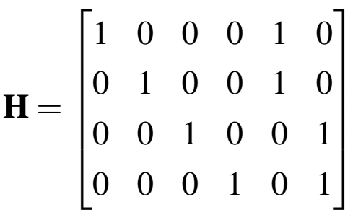



Block length n
$$d_{c}=2$$
$$d_{v}=1$$
$$d_{v}=2$$

